Slide 1
The Bank Marketing Campaign
Data science Course
Presented by Abdullah Al-Qithmi

Slide 2

outline
Problem Statement
Business Understanding
Dataset Description
EDA
Data Preparation & Cleansing
Model
Evaluation Metrics
Future work

Slide 3

Problem Statement
A Portuguese bank suffers from a decline in revenue.
The Root Cause:
Expensive and ineffective campaigns
Low customer deposits
Our Aim
Improve the effectiveness of the marketing campaign
How?
Create a Model that is able to identify potential subscribers

Slide 4
Business Understanding
Term Deposit: is a deposit held at a financial institution that has a fixed term
Direct Marketing: is a form of communicating an offer, where organizations communicate directly to a pre-selected customers group.
Retail Banking: is the provision of services by a bank to the general public, rather than to companies.
Default: failure to repay a loan.

Slide 5

Dataset Description
Real-world data was collected from the previous direct telemarketing campaigns of Portuguese retail bank
Collected from May 2008 to June 2013
Consisted of 41,188 rows & 21 columns
Often, more than one contact to the same client was required
Three main groups of Attributes:
Demographic Information — age, job, education, etc.
Time Characteristics of the Call — day, month, & duration
Characteristics of the Campaign — contact, campaign, pdays, previous, & poutcome
Both Inbound & Outbound marketing techniques were used

Slide 6
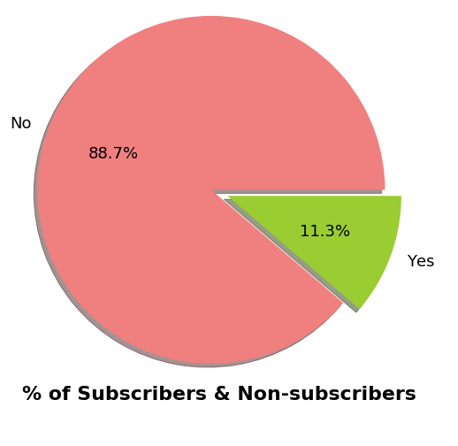
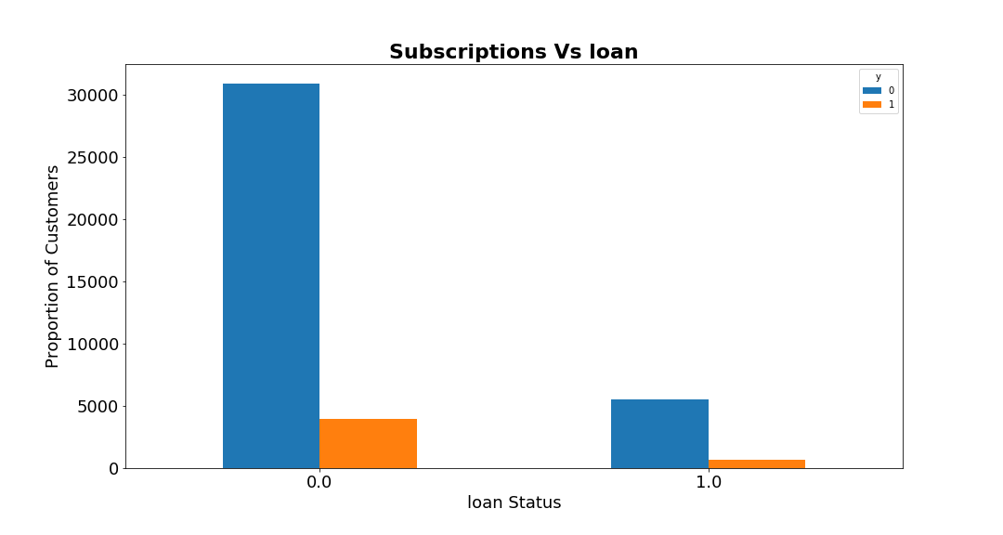
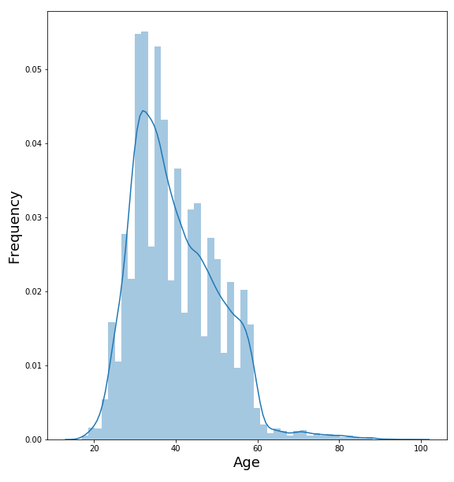
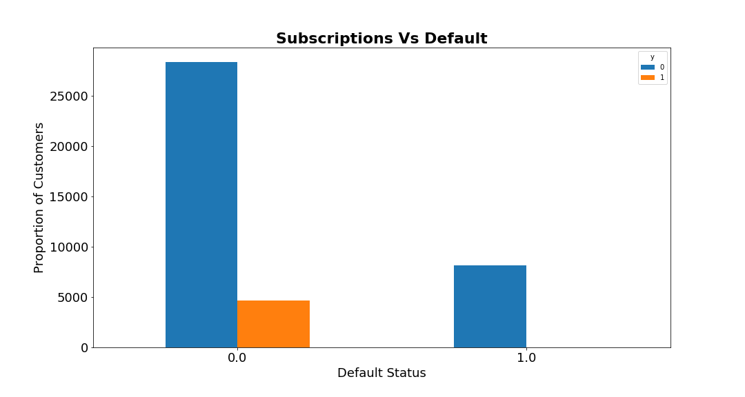
EDA
A
B
C
D

Slide 7
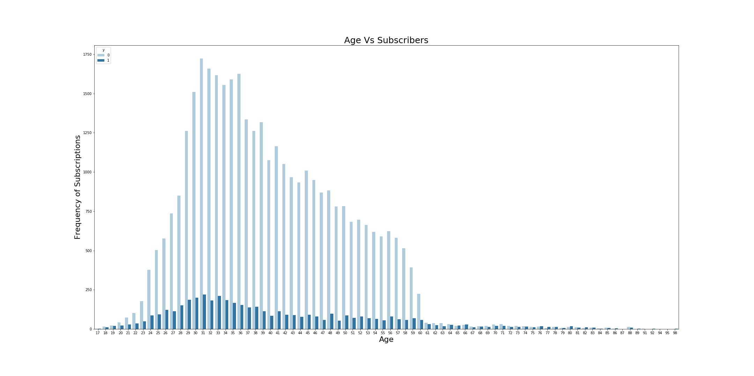
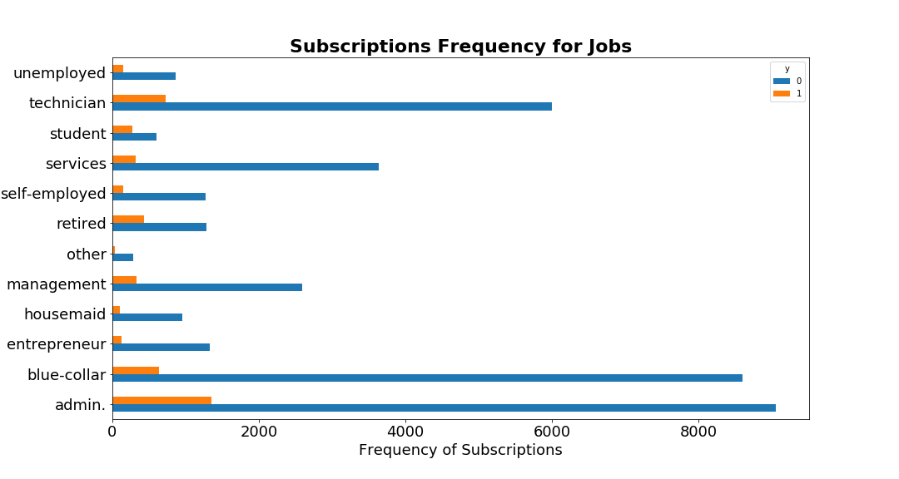
EDA (cont.)

Slide 8
Data Preparation & Cleansing
Drop Columns
Pdays Attribute
3 Economic Attributes
Missing Values
Loan & Housing
Job & Education
Categorical Attributes
Education & Marital
Imbalanced Classes
Outliers Values
Marital
Default
Duration
Age
Target 'y'
96% Missing data
High correlation
Impute based on y
KNN log
separate category
Drop missing values
Reduce
SMOTE

Slide 9
Model
Because it’s mainly a classification problem, we can choose one of the following:
Logistic Regression
K-Nearest Neighbours
Decision Tree
Neural Network
Support Vector Machine
The chosen model is Logistic regression
Easy to implement
Easy to explain

Slide 10
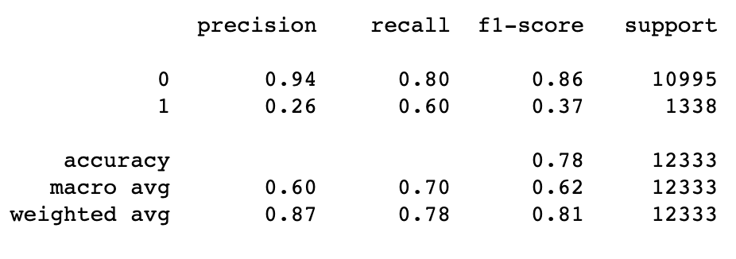
Evaluation Metrics
Baseline
0.891511
Accuracy Score
0.7751560852996027
misclassification
0.2248439147003973
ROC AUC
0.6996140724381446
TP 8753
FP 2242
TN 807
FN 531
FN -The client is a potential subscriber, but we did not contact him
FP - The Client is not a potential subscriber, and we contacted him

Slide 11
Future work
Remove the outlier values of the age attributes
Use different classification models
Try to treat the imbalanced classes of the output values with different methods
Come with a different set of features
Try to reduce both False Negatives and False Positives

Slide 12
Thank yoU
ANY Questions?

